Slide 1
Web3

Slide 2
What Is Web3?
Web3 represents the next generation of the internet, one that focuses on shifting power from big tech companies to individual users.
https://ethereum.org/en/web3/

Slide 3
What Is Web3?
Web3 can be understood as the “read/write/own” phase of the Internet.
Rather than just using free tech platforms in exchange for our data, users can participate in the governance and operation of the protocols themselves. This means people can become participants and shareholders, not just customers or products.
https://www.coindesk.com/learn/what-is-web-3-and-why-is-everyone-talking-about-it/

Slide 4
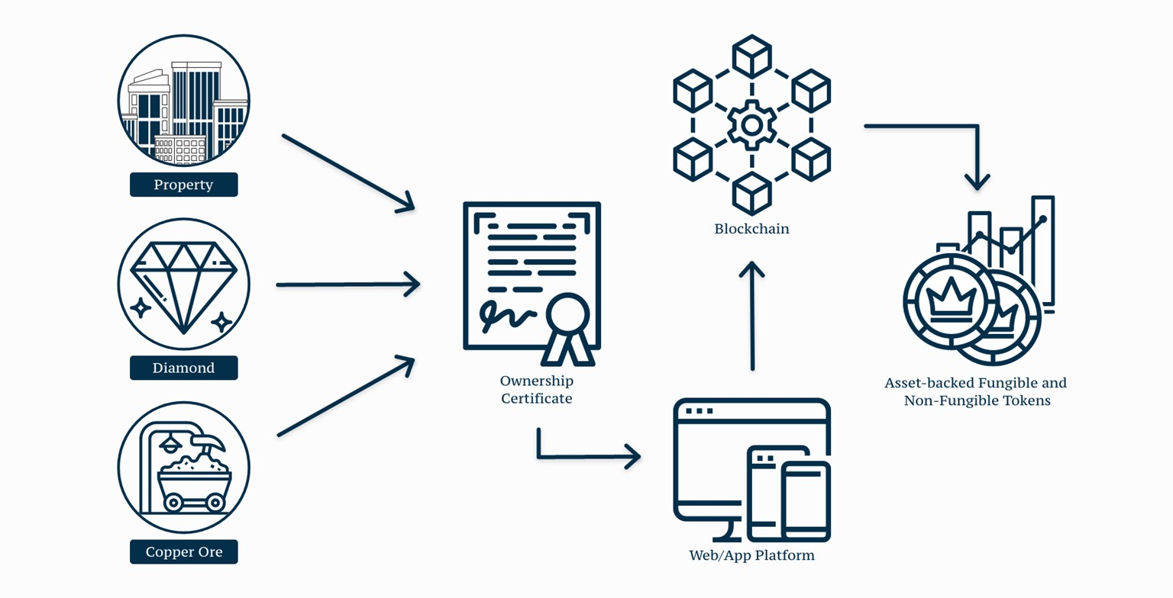
Digital asset tokenization is the process whereby ownership rights of an asset are
represented as digital tokens and stored on a blockchain.
https://www.blockchain-council.org/blockchain/asset-tokenization/

Slide 5
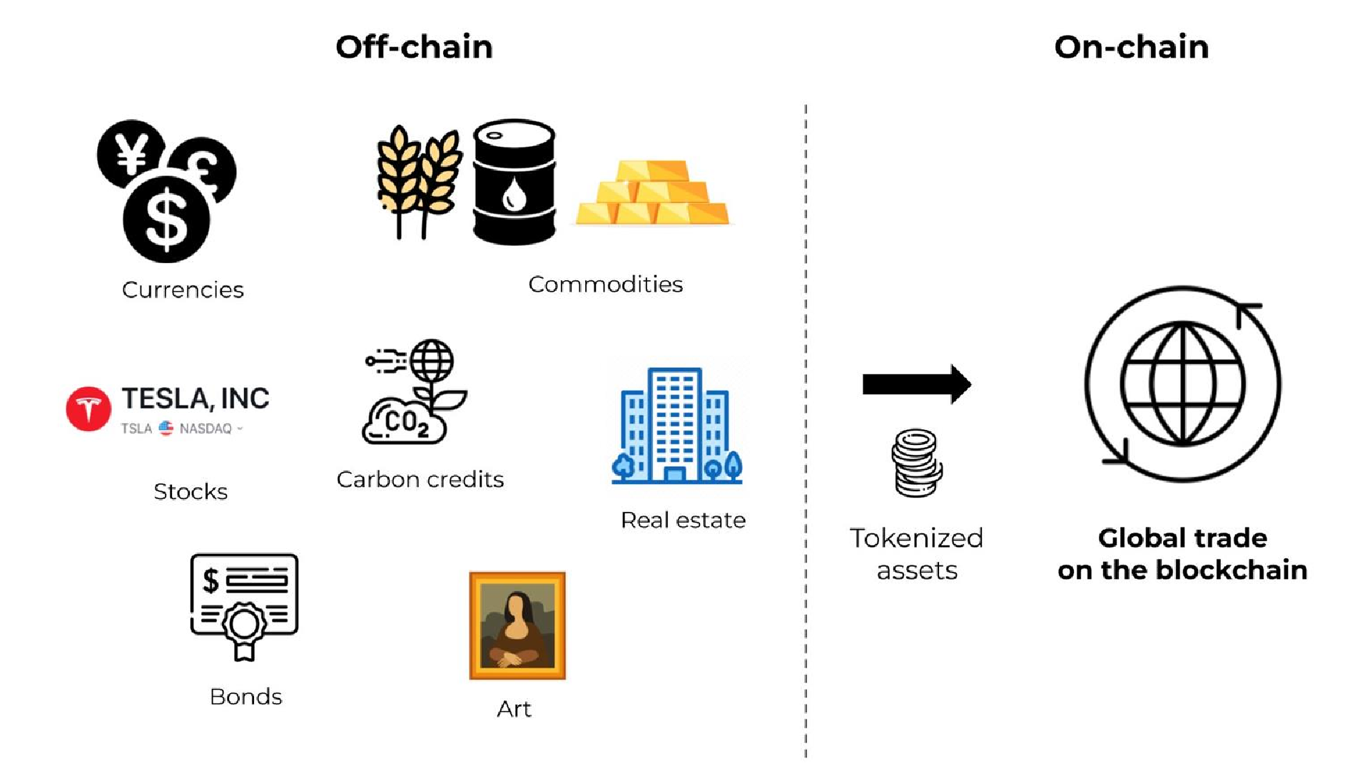
https://twitter.com/77MichaelR/status/1602015570701983746

Slide 6
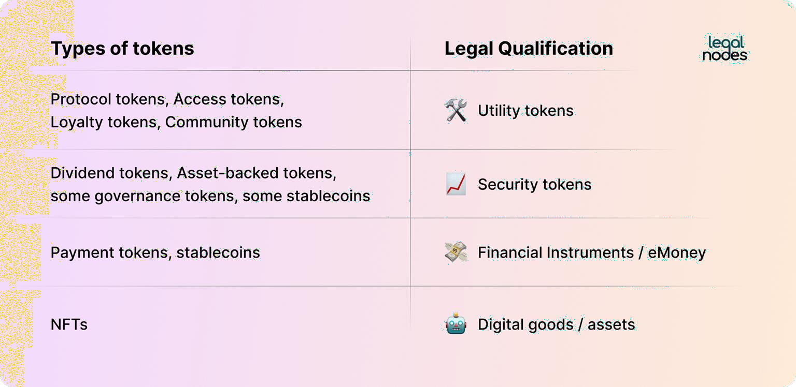
Token Asset Classes
https://legalnodes.com/article/token-types-legal-status

Slide 7
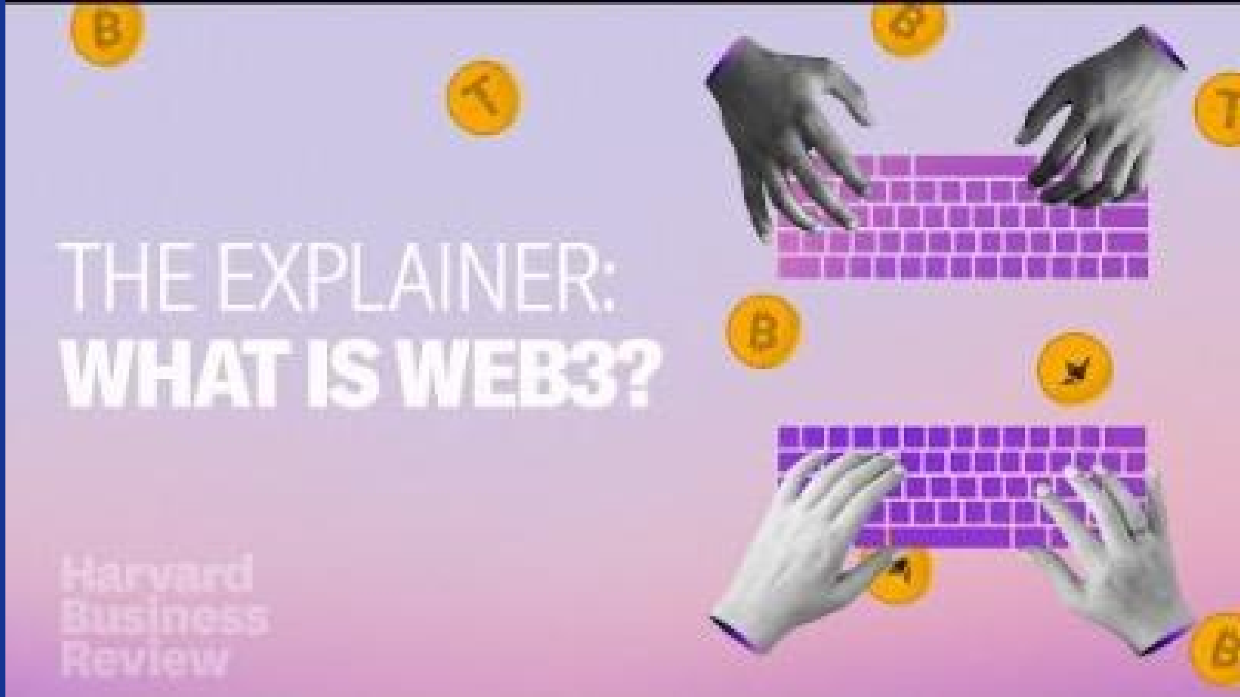

Slide 8
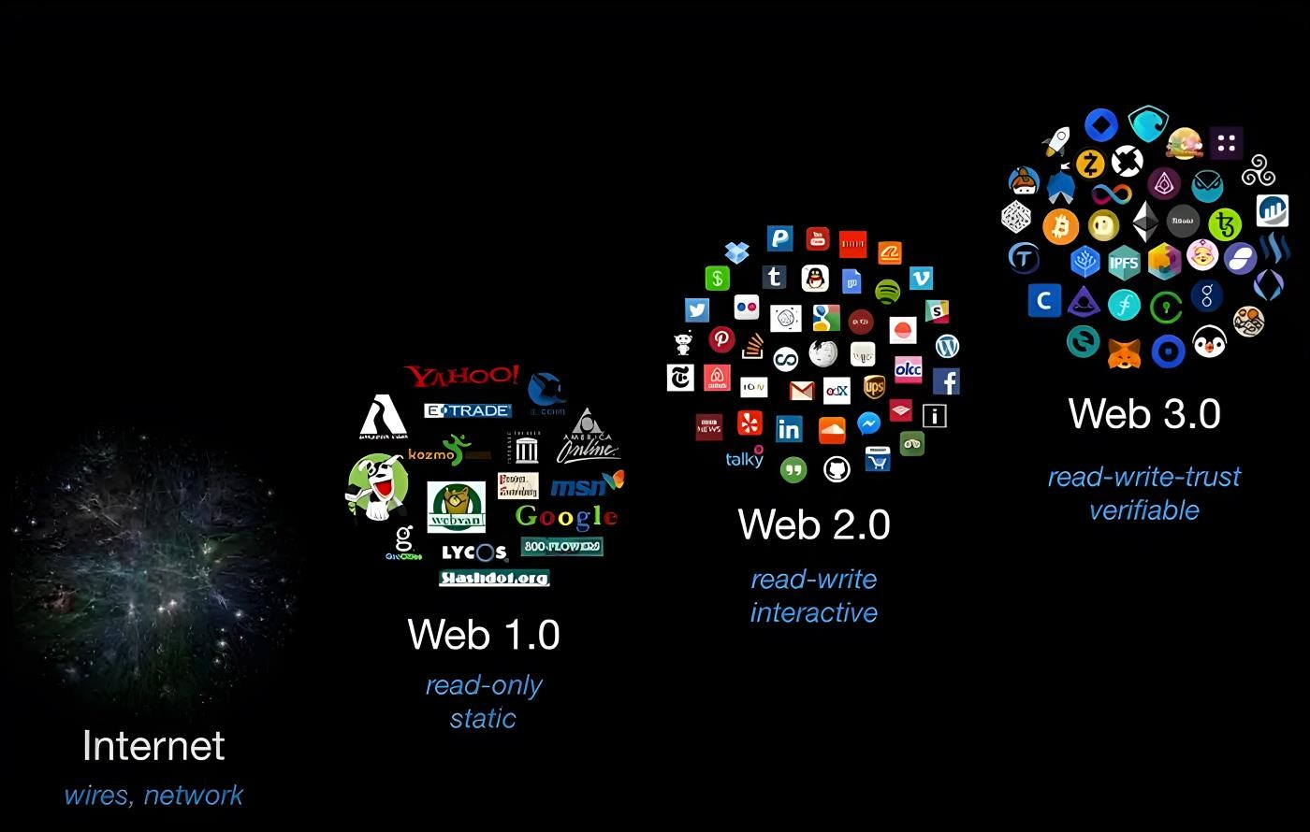
https://youyaa.com/web3-so-far-and-predictions/

Slide 9
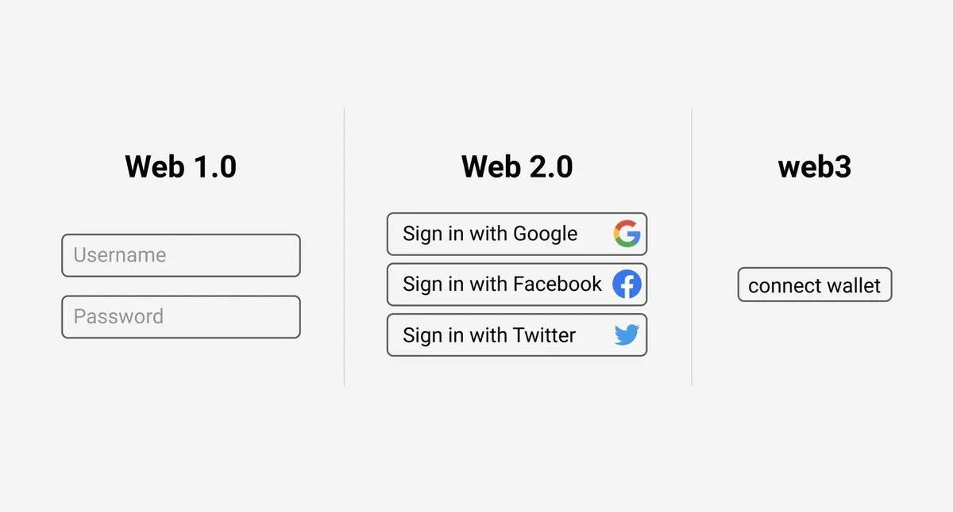
The evolution of the web is delivering a new status quo for users, designing valuable experiences at each innovation wave
https://businesstechguides.co/what-is-the-web3-stack

Slide 10
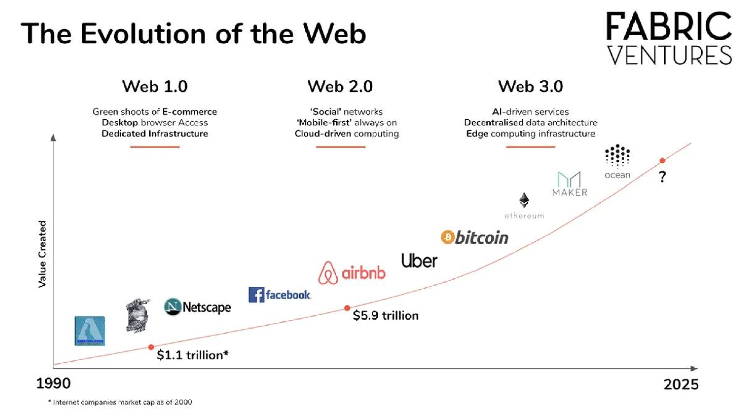
Meet Ocean: Tokenized AI & Data
Monetize AI models & data while preserving privacy
Dai is a stable, decentralized currency that does not discriminate. Any individual or business can realize the advantages of digital money.

Slide 11
Core Ideas in Web3
Web3 is decentralized: instead of large swathes of the internet controlled and owned by centralized entities, ownership gets distributed amongst its builders and users.
Web3 is permissionless: everyone has equal access to participate in Web3, and no one gets excluded.
Web3 has native payments: it uses cryptocurrency for spending and sending money online instead of relying on the outdated infrastructure of banks and payment processors.
Web3 is trustless: it operates using incentives and economic mechanisms instead of
relying on trusted third-parties.

Slide 12
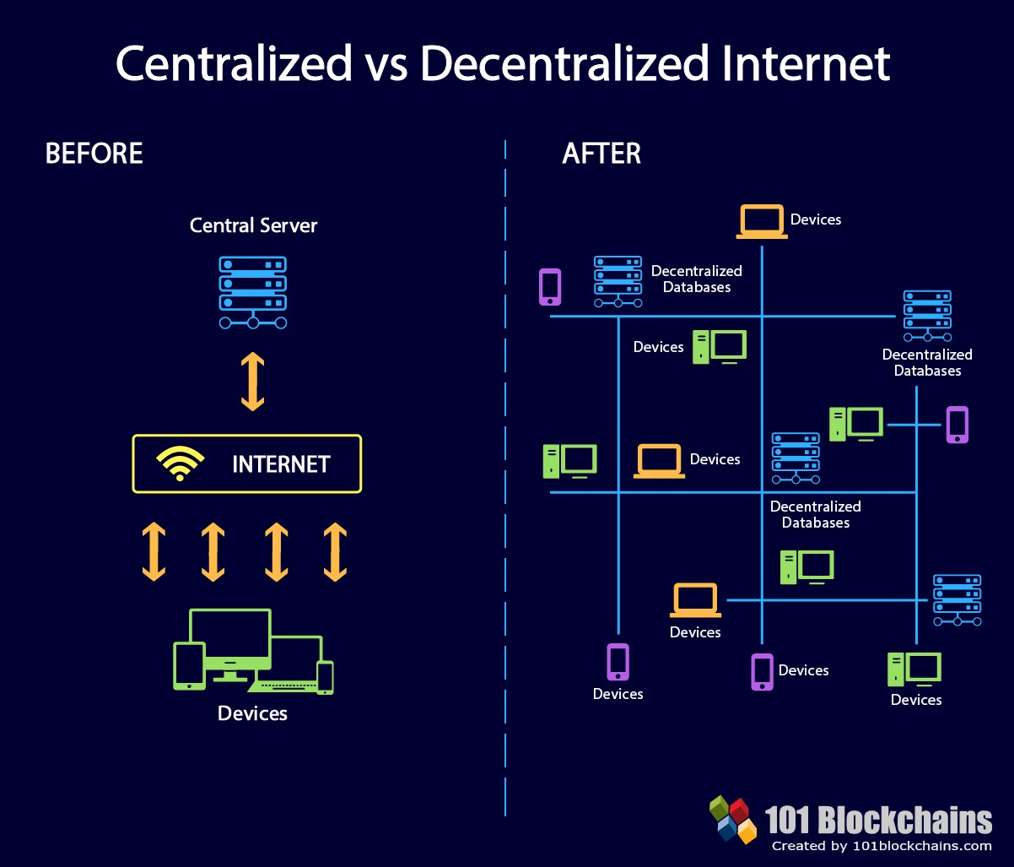
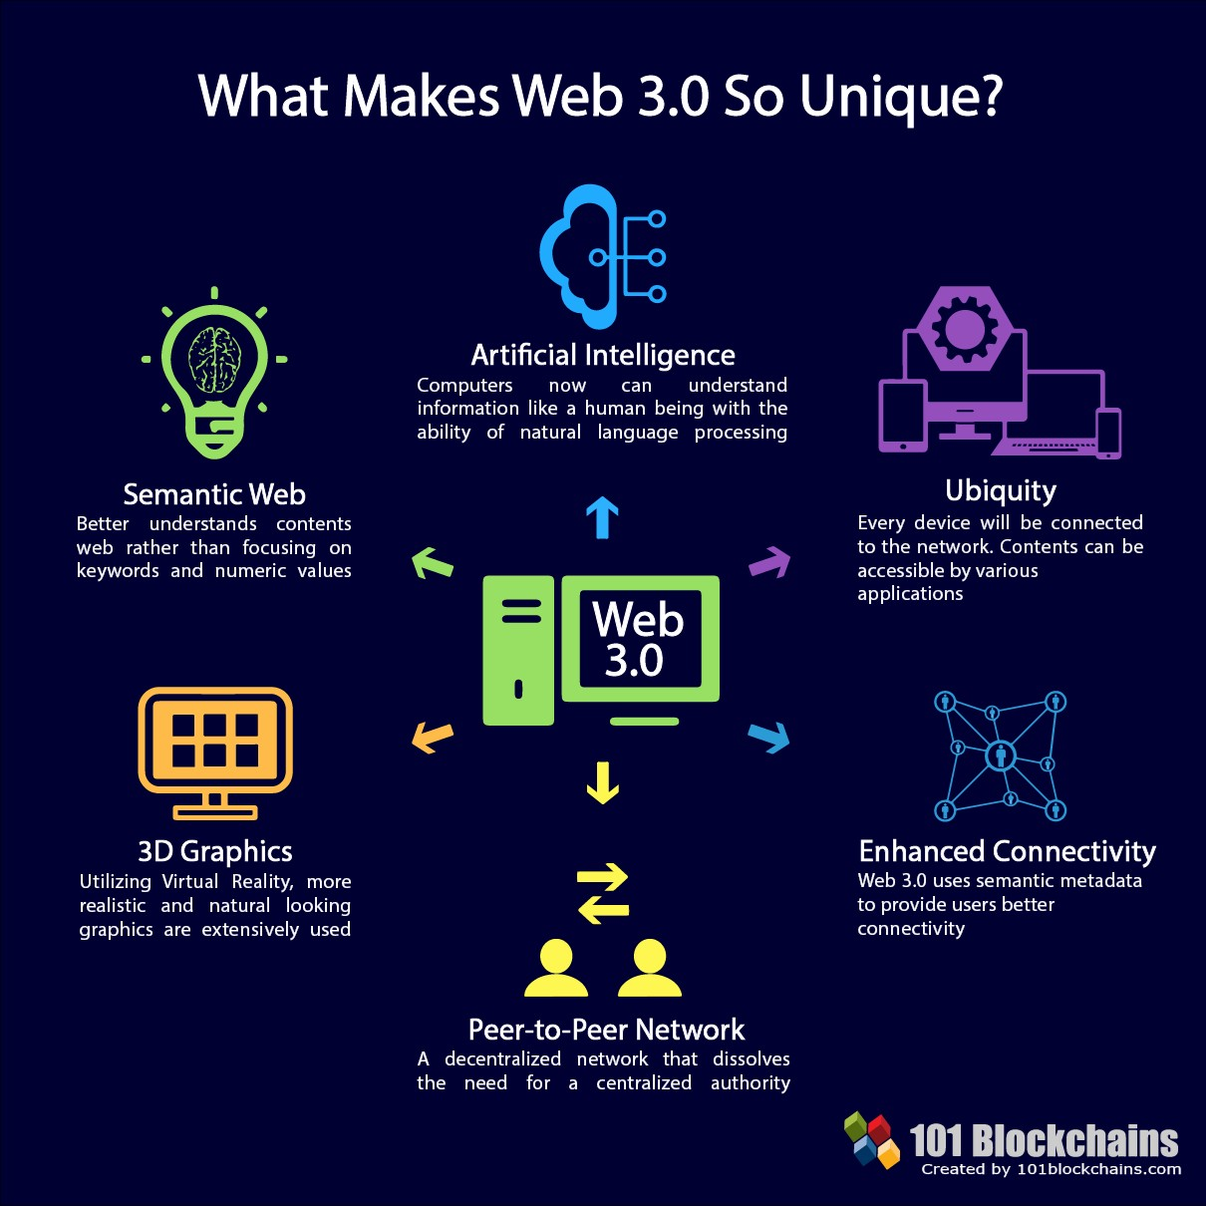
https://101blockchains.com/web-3-0-blockchain-technology-stack/

Slide 13
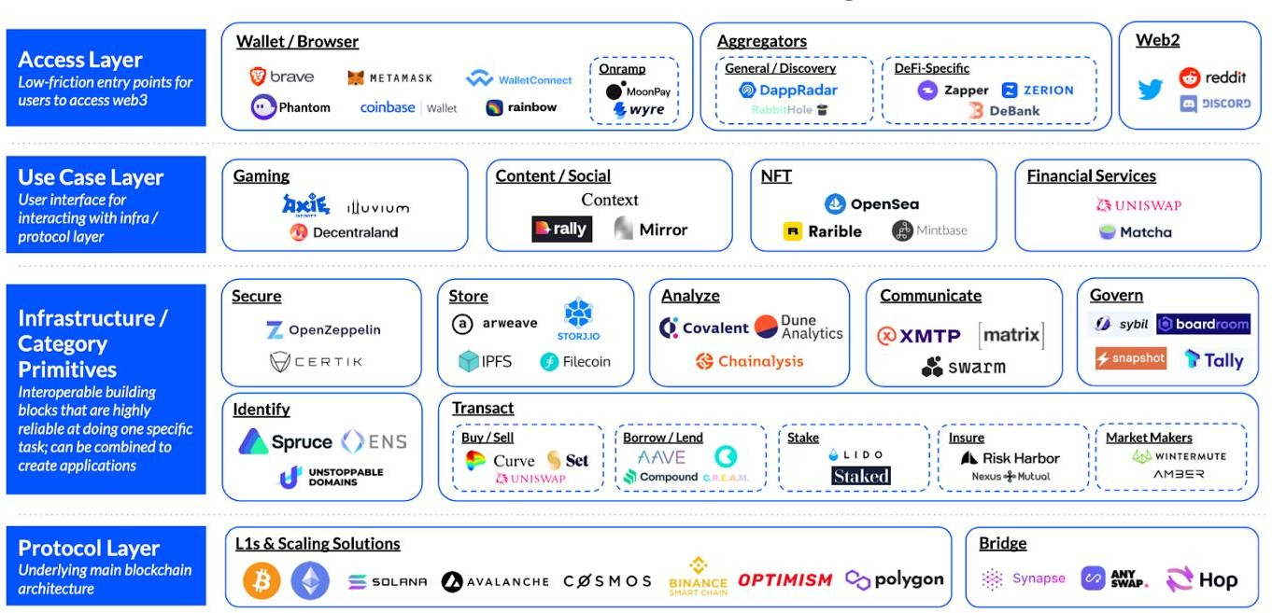
The Web3 Tech Stack
https://www.coinbase.com/blog/a-simple-guide-to-the-web3-stack

Slide 14
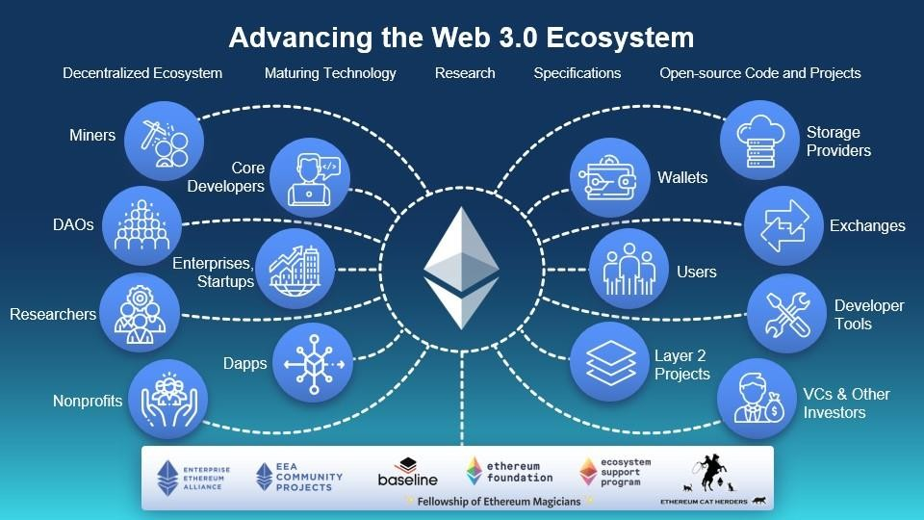
The Ethereum Ecosystem for the Web 3.0
https://entethalliance.org/advancing-the-web-3-0-ecosystem%E2%80%8B/

Slide 15
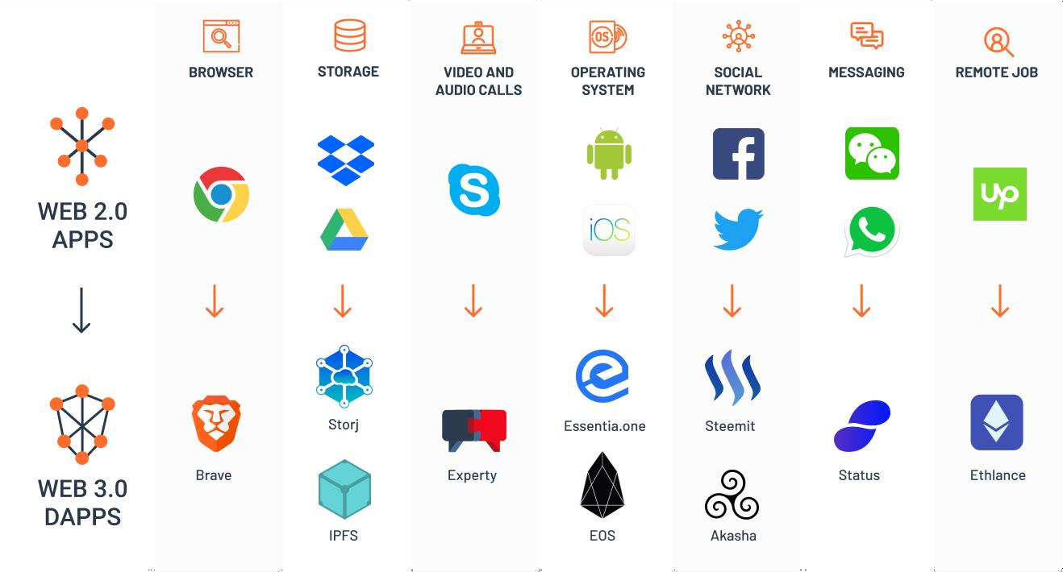
Multiple use cases evolve to Web3 in the form of dApps

Slide 16

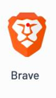
Browser
Brave is a fast, secure, and private web browser that blocks ads and trackers by default, protects your online privacy, and offers crypto rewards for opting in to first-party ads.

Slide 17
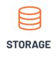
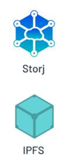
Storage
Storj is a decentralized cloud storage platform that segments and distributes data across a global network, providing better security, privacy, and performance.
IPFS (InterPlanetary File System) is a peer-to-peer hypermedia protocol designed to make the web faster, safer, and more open, providing a storage layer for Web 3.0.

Slide 18


Video calls
Experty is an AI-driven platform that provides real-time crypto insights by aggregating news and social media sources, revolutionizing the industry with significantly less overhead.

Slide 19


Operating Systems
Essentia.one is an all-in-one manager for your crypto life, aiming to make blockchain technology widely accessible and drive the transition from Web 2.0 to Web 3.0
EOS is a blockchain platform for the development of decentralized applications (dapps), with an operating system-like construction and a focus on performance and scalability.

Slide 20


Social Networks
Steemit is a decentralized social media platform running on the Steem blockchain, rewarding users for creating and curating content
Akasha is a pioneering digital connection platform integrating virtual reality and Web 3.0, offering communication, adventure, and education.

Slide 21

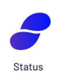
Messaging
Status is a messaging app. It is an open-source, decentralized messaging platform that also includes a non-custodial crypto wallet and a Web 3.0 browser.

Slide 22

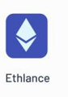
Remote Jobs
Brave is a fast, secure, and private web browser that blocks ads and trackers by default, protects your online privacy, and offers crypto rewards for opting in to first-party ads.

Slide 23
Multiple use cases evolve to Web3 in the form of dApps
Brave is a fast, secure, and private web browser that blocks ads and trackers by default, protects your online privacy, and offers crypto rewards for opting in to first-party ads.

Slide 24
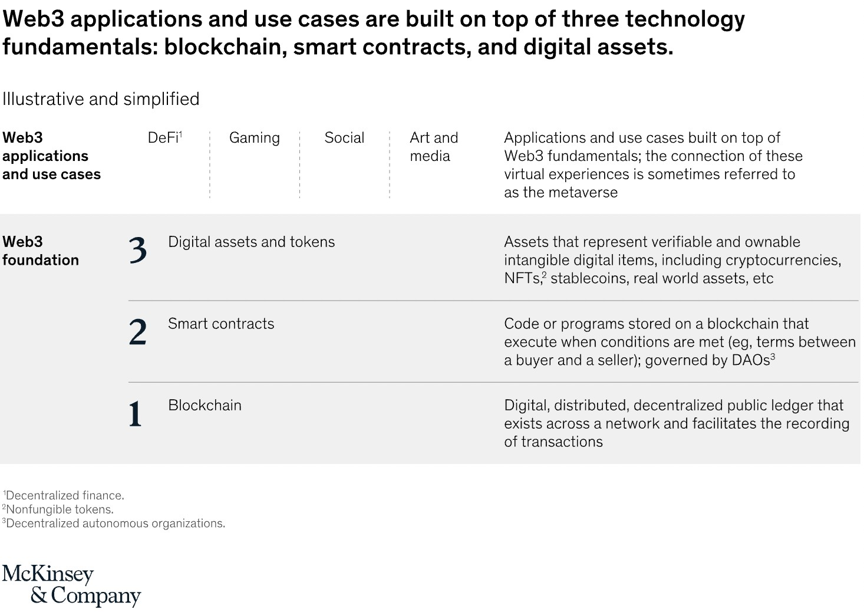
https://www.mckinsey.com/industries/financial-services/our- insights/web3-beyond-the-hype

Slide 25
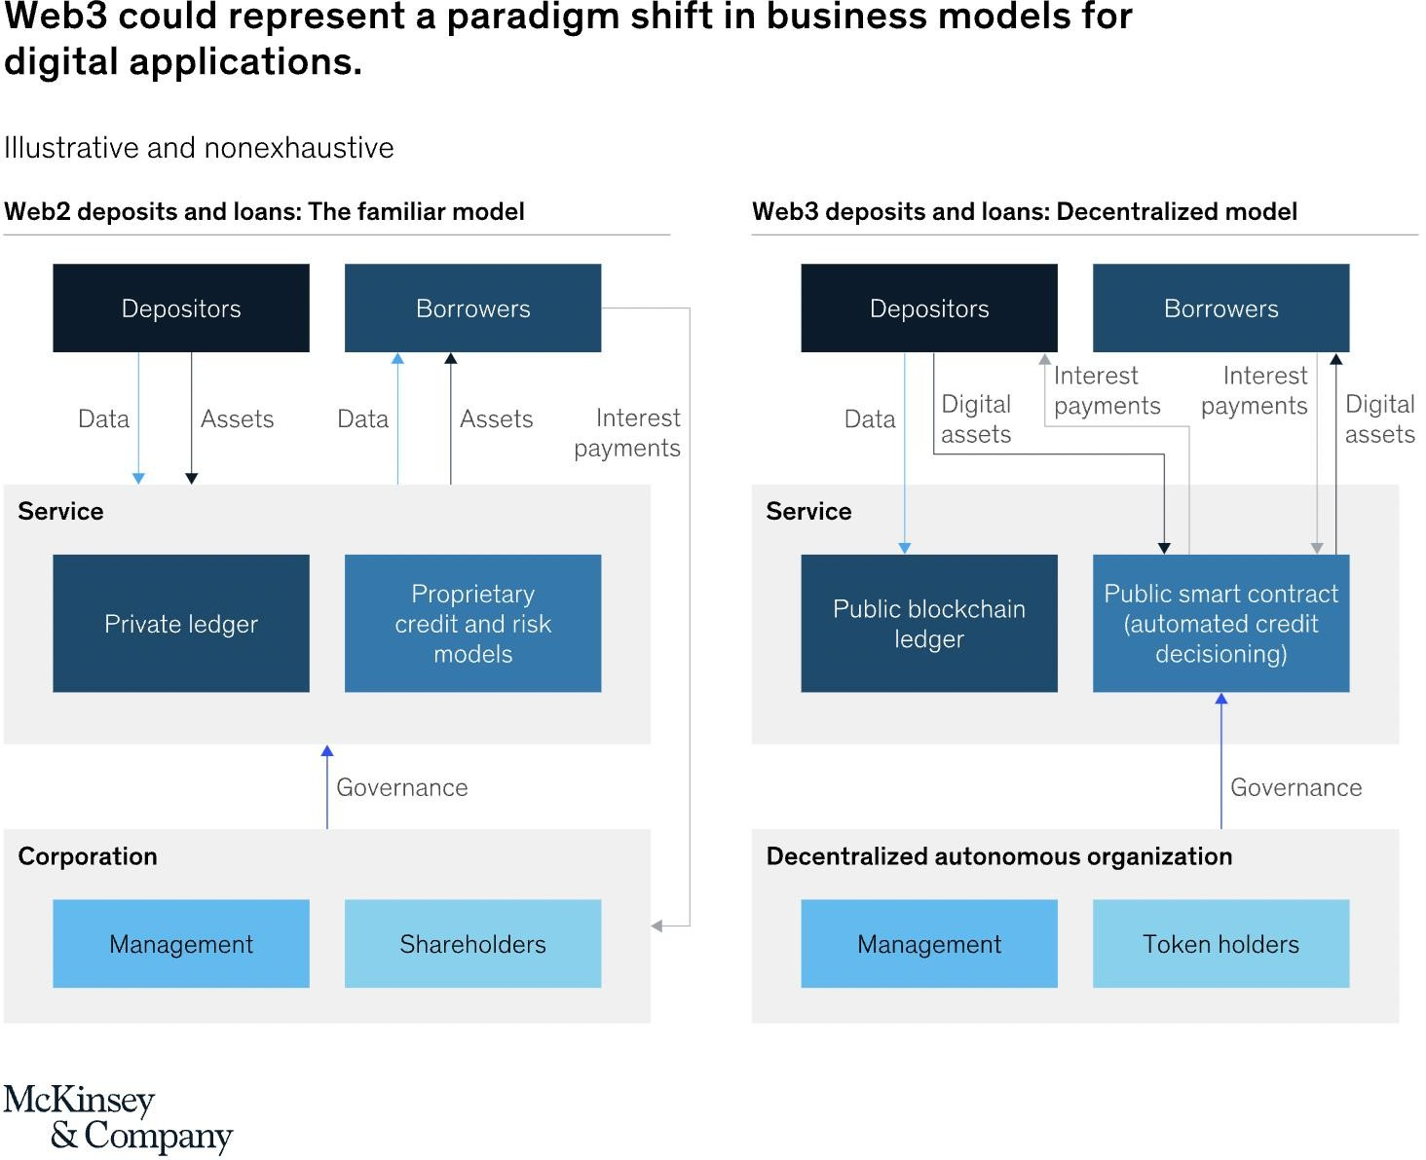
Decentralized Finance (DeFi) Example
https://www.mckinsey.com/industries/financial-services/our- insights/web3-beyond-the-hype

Slide 26
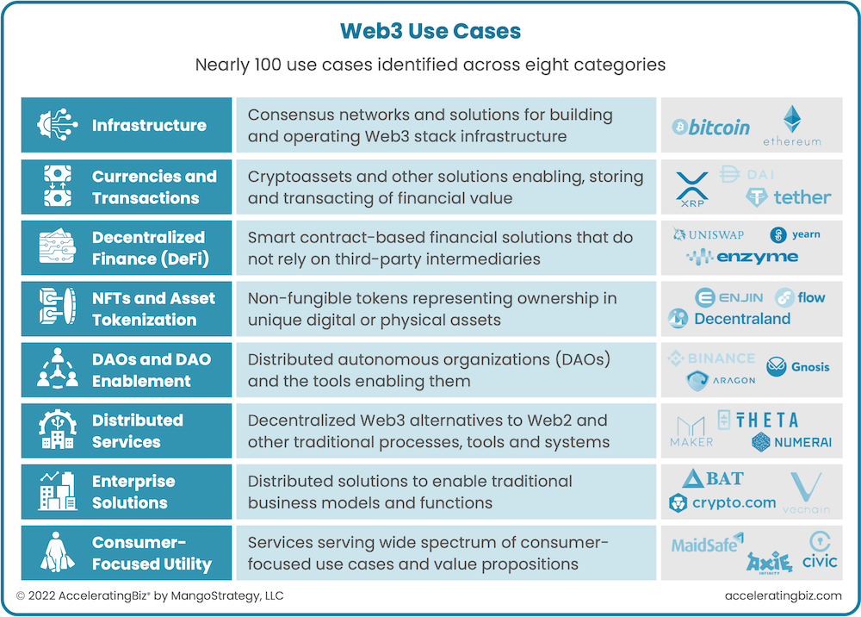
Medium Article

Slide 27

[Climatetrade] : An all-in-one platform for understanding your role in sustainable transition and taking transparent climate action. (Una plataforma integral para comprender tu papel en la transición sostenible y tomar medidas climáticas transparentes).
https://climatetrade.com/

Slide 28
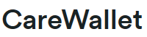
2. [CareWallet] : A blockchain-based crowdfunding platform specifically designed for healthcare needs. (Una plataforma de financiación colectiva basada en blockchain diseñada específicamente para necesidades de atención médica).
https://devpost.com/software/carewallet
https://devpost.com/software/carewallet

Slide 29

3. [Book.io] : A Web3 marketplace for buying, reading, and selling eBooks and Audiobooks. (Un mercado Web3 para comprar, leer y vender libros electrónicos y audiolibros).
https://book.io/

Slide 30

4. [Algorand Technologies] : A blockchain-based transactions platform designed to address blockchain's scaling challenges. (Una plataforma de transacciones basada en blockchain diseñada para abordar los desafíos de escalabilidad de blockchain).
https://algorandtechnologies.com/

Slide 31

5. [Lofty.ai] : A platform that tokenizes fractional real estate investing. (Una plataforma que tokeniza la inversión fraccionada en bienes raíces).
https://www.lofty.ai/

Slide 32

6. [Ctrl Alt] : Alternative Assets like shares in Fintechs. (Inversión alternativa principalmente en Startups y Fintech).
https://www.ctrl-alt.co/

Slide 33

7. [ANote Music] : A platform that offers the rights from artist catalogues to investors through an auction system. (Una plataforma que ofrece los derechos de los catálogos de artistas a los inversores a través de un sistema de subastas).
https://www.anotemusic.com/

Slide 34
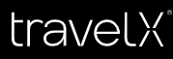
8. [TravelX] : A platform that helps airlines distribute Tickets as NFTickets, they are proposing a secondary market for tickets. (Una plataforma que ayuda a las aerolíneas a distribuir boletos como NFTickets y proponen un mercado secundario para los tickets).
https://www.travelx.io

Slide 35
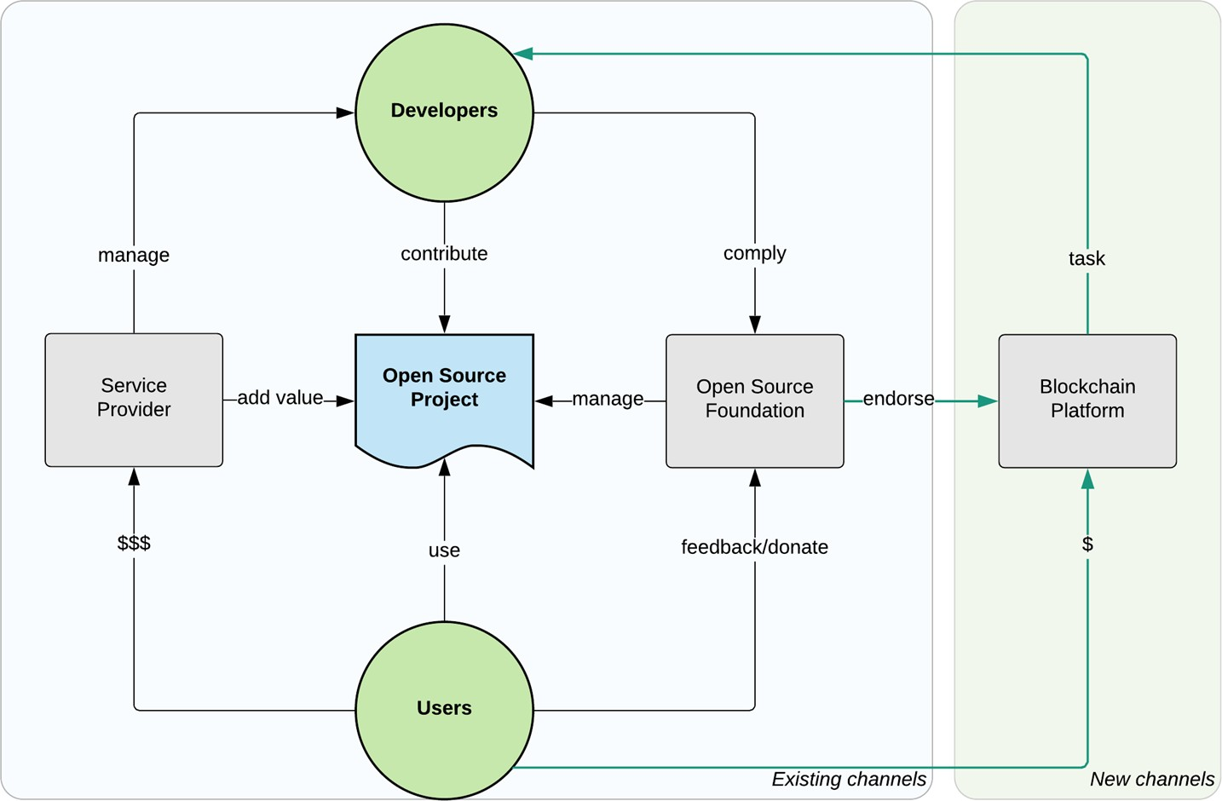
Tokenization is the perfect incentive for open source projects
https://opensource.com/article/18/8/open-source-tokenomics

Slide 36
What are DAOs (Decentralized Autonomous Organizations)
A DAO is a collectively-owned, blockchain-governed organization working towards a shared mission.
DAOs allow us to work with like-minded folks around the globe without trusting a benevolent leader to manage the funds or operations.
Instead, blockchain-based rules backed into the code define how the organization works and how funds are spent.
Decisions are governed by proposals and voting to ensure everyone in the
organization has a voice, and everything happens transparently on-chain.
https://ethereum.org/en/dao/

Slide 37
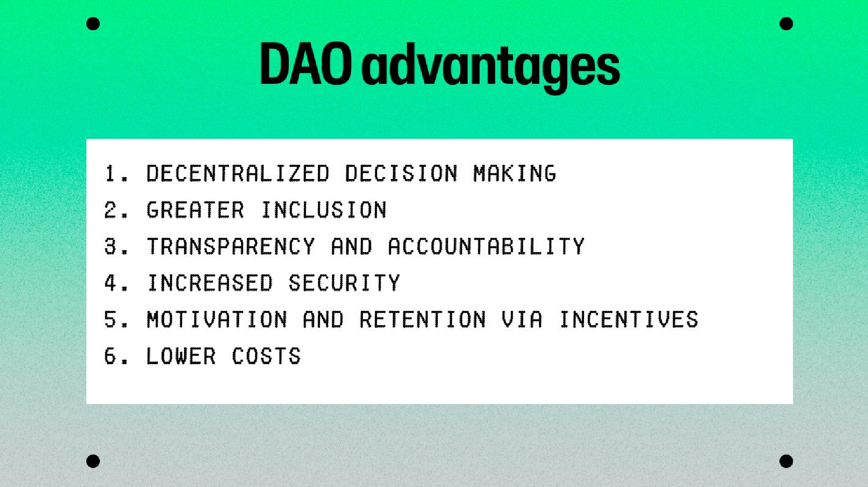
https://www.moonpay.com/learn/cryptocurrency/what-is-a-dao

Slide 38
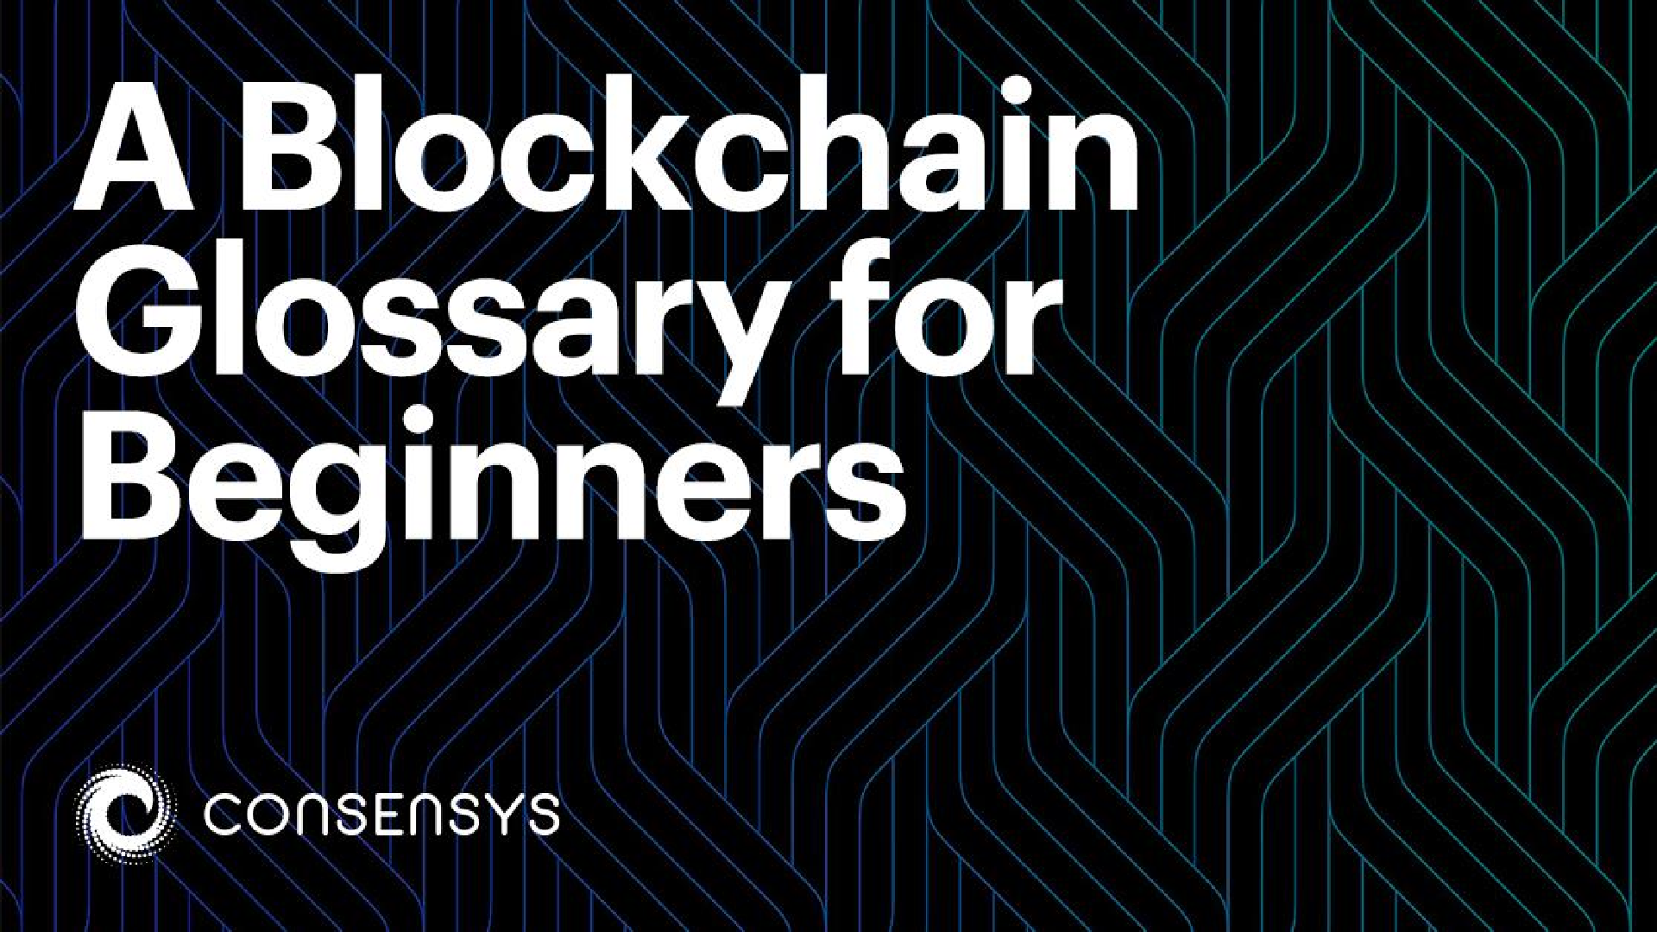
https://consensys.net/knowledge-base/a-blockchain-glossary-for-beginners/

Slide 39
Workshop

Slide 40
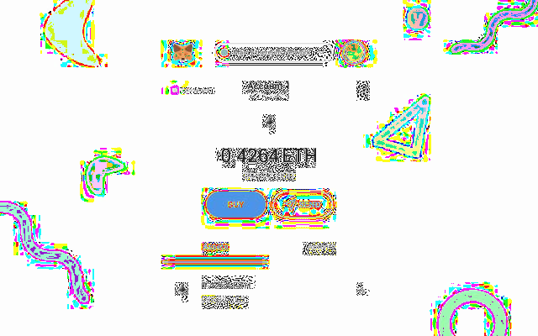
Let’s create a wallet.
Using a metamask wallet
Private keys
Understanding addresses (0x)
Networks & Blockchains
Nodes & Validations
Gas Fees
Blockchain Explorer
Interacting with a smart contract via a D’App
Tokens & NFTS
Minting a token (fungible and non-
fungible)
Sending tokens
Dispersing tokens

Slide 41
Instructions
[PHASE 1]
Install a Wallet Extension on Chrome*. (ON YOUR OWN LAPTOP)
First install metamask on professor’s computer and show students the manual process of adding networks and tokens.
Students should be able to install coinbase wallet to keep it simple.
Go through the seed phase process.
Open text edit and copy - paste the words. save this file safely.
it is also recommended you note these words down on a piece of paper that you store securely.
You will have to confirm the words in order OR the first and last word.
You will see a public wallet address starting with 0x…
copy this on a separate text edit file. This is your Public Wallet Address. (your IBAN)
You can go into advanced settings to copy the private key into a text edit file too. Create a password to protect the extension
You now have a public address, and go on a blockchain explorer, such as Polygonscan to check that there are no transactions. Paste your wallet address into the field.
*NOTE: browser cannot be synchronized with IE faculty account, as it blocks installing extensions.

Slide 42
Instructions
FUND YOUR ACCOUNT [PHASE 2]
You should have already created your main faculty account and
pasted it into the IE IMPACT Wallet Address Database
Once we have all the wallets, we will fund them with $30
You will already have a pre-funded account with $30 (half in USDC half in MATIC)
MATIC (Polygon’s native token) will be used for gas fees (network) and
USDC will be used to demo a swap transaction or purchase an NFT minted by the groups.
You can show this asset on your balance
You can click on the three dots, view in explorer, and look for ERC20 transaction.
You should see the transaction (with a TX hash) that corresponds to the incoming assets.
If you have 2 wallets, feel free to move the assets from one wallet to another as a demonstration to the students.
*NOTE: browser cannot be synchronized with IE faculty account, as it blocks installing extensions.

